Slide 1

Mathematics for Computer Science MIT 6.042J/18.062J
The Well Ordering Principle, II
This work is licensed under a Creative Commons Attribution-Noncommercial-Share Alike 3.0 Unported License.

Slide 2
Prime Products
Thm: Every integer > 1 is a
product of primes.
Proof: (by contradiction) Suppose
{nonproducts} is nonempty.
By WOP,
there is a least m > 1 that is a
nonproduct.
This m is not prime
(else is a product of 1 prime)

Slide 3
Prime Products
Thm: Every integer > 1 is a
product of primes.
…So m = j·k for integers j,k
where m > j,k > 1.
Now j,k < m
so both are prime products:
j = p₁·p₂··· p₉₄ k = q₁·q₂···q₂₁₃

Slide 4
Prime Products
Thm: Every integer > 1 is a
product of primes.
…now
m = j·k = p₁·p₂···p₉₄·q₁·q₂···q₂₁₃
is prime product, contradiction.
So {counterexamples} = ∅. QED

Slide 5
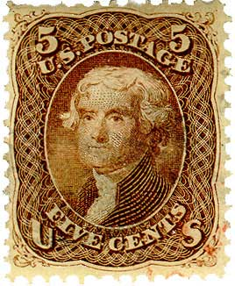
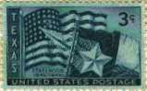
Well Ordered Postage
available stamps:
5¢
3¢
n is postal if can make
(n+8)¢ postage from
3¢ & 5¢ stamps.

Slide 6
Well Ordered Postage
available stamps:
5¢
3¢
Thm: Every number is postal.
Prove by WOP. Suppose not.
Let m be least counterexample.

Slide 7
Well Ordered Postage
available stamps:
That is,
m is not postal,
any number < m is postal
5¢
3¢

Slide 8
Well Ordered Postage
0 is postal:
so m ≠ 0

Slide 9
Well Ordered Postage
m ≠ 1:
m ≠ 2:
Hence, m ≥ 3.

Slide 10
Well Ordered Postage
Now m-3 is a number < m,
so is postal.
But then m
is postal too:
= m+8¢
+
3¢
(m-3)+8¢
contradiction!

